Slide 1
Review
For Lectures Taught By Xin Huang

Slide 2
Scope
Overview
Overview II
Overview III - Operating-System Structures
Overview IV - Introduction of Security
Processes
Threads
CPU Scheduling
ProcessSync
Deadlock

Slide 3
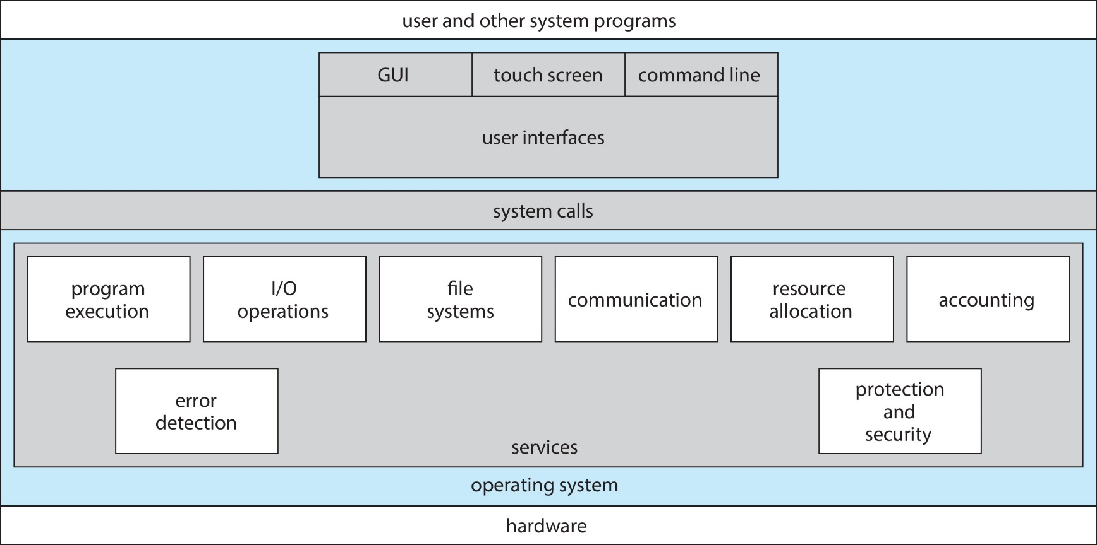
A View of Operating System Services
Operating systems provide an environment for execution of programs and services to programs and users

Slide 4
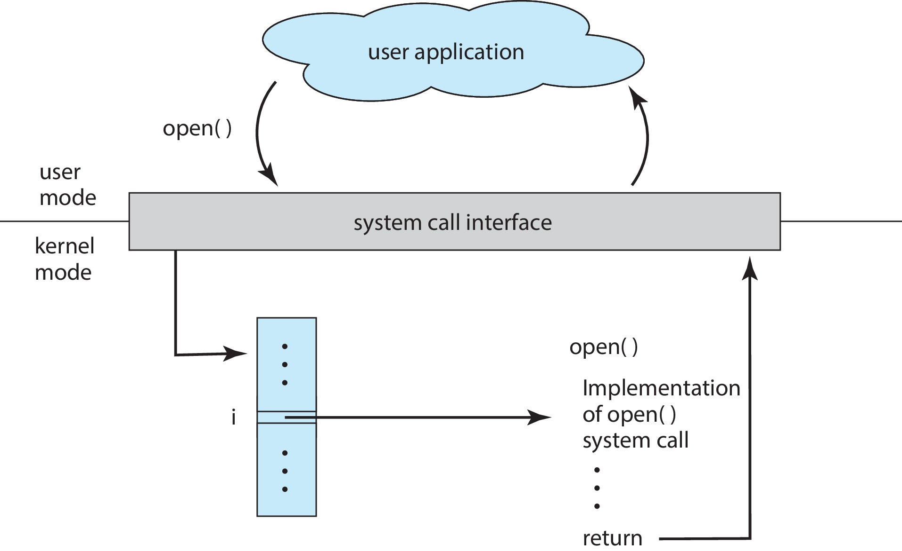
API – System Call – OS Relationship

Slide 5
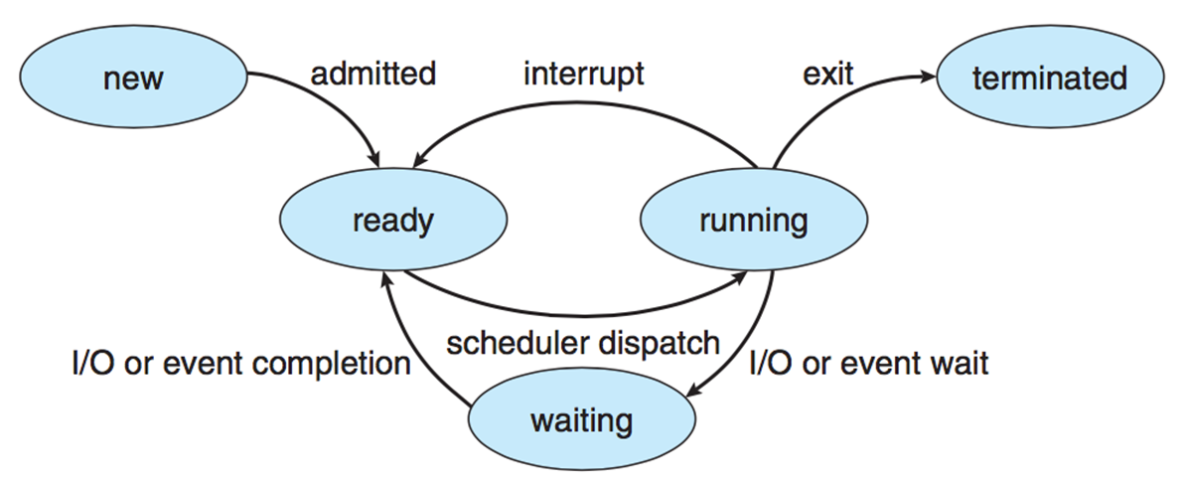
Process

Slide 6
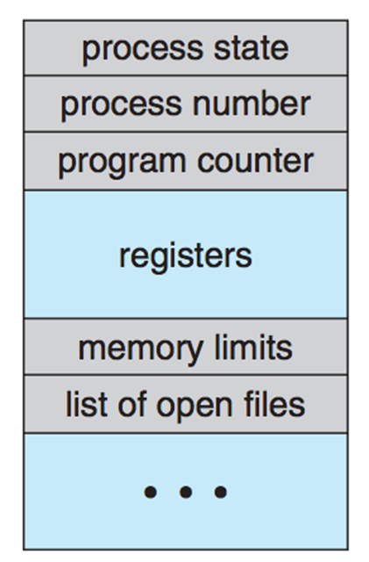
Process Control Block (PCB)

Slide 7
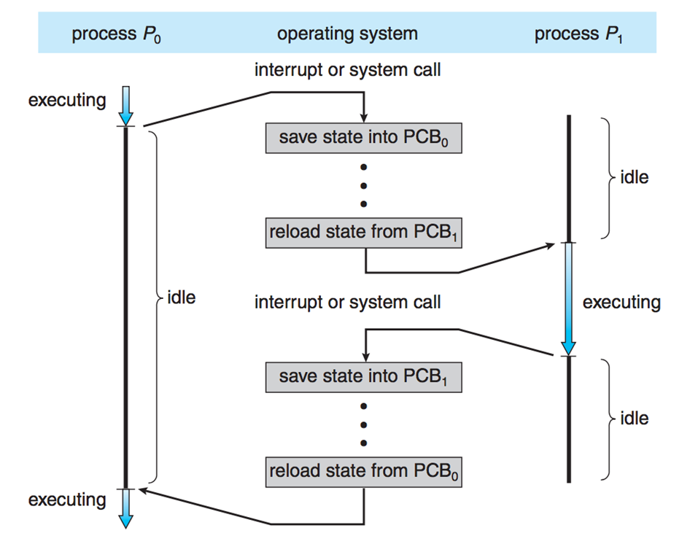
Context Switch

Slide 8
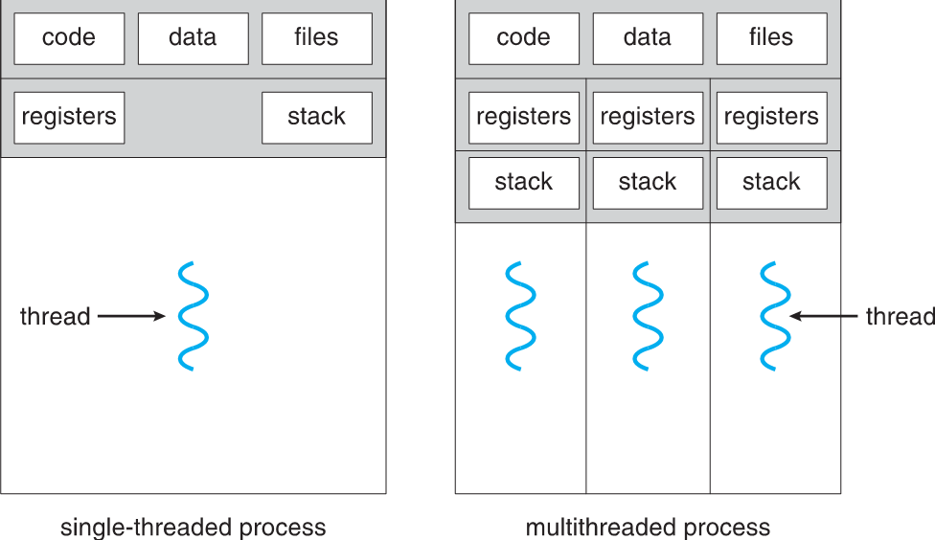
Thread

Slide 9
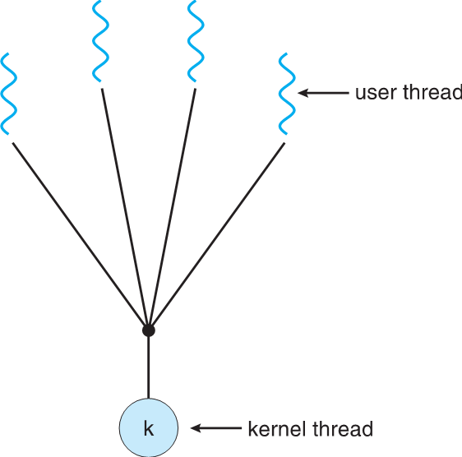
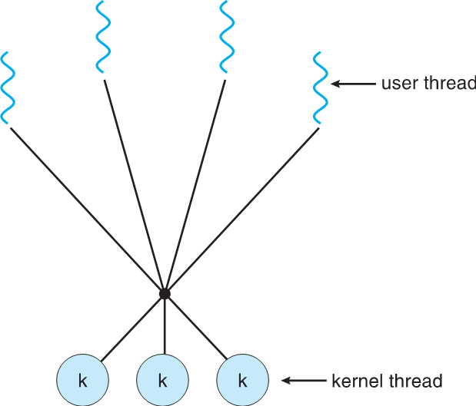
User Threads and Kernel Threads

Slide 10
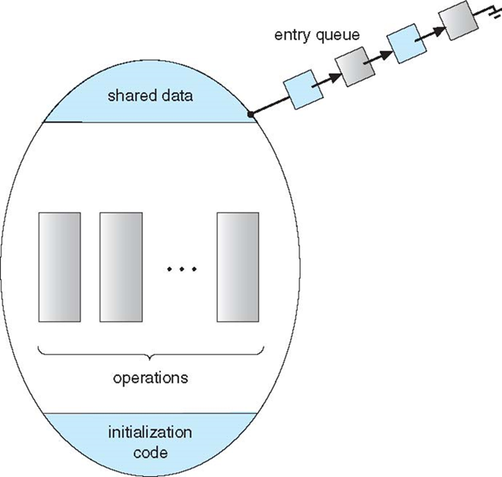
Monitor

Slide 11
Critical Section
Consider this execution interleaving with “count = 5” initially:
S0: producer execute register1 = counter {register1 = 5} S1: producer execute register1 = register1 + 1 {register1 = 6} S2: consumer execute register2 = counter {register2 = 5} S3: consumer execute register2 = register2 – 1 {register2 = 4} S4: producer execute counter = register1 {counter = 6 } S5: consumer execute counter = register2 {counter = 4}
Peterson’s Solution, synchronization hardware, mutex lock/spin lock, semaphores

Slide 12
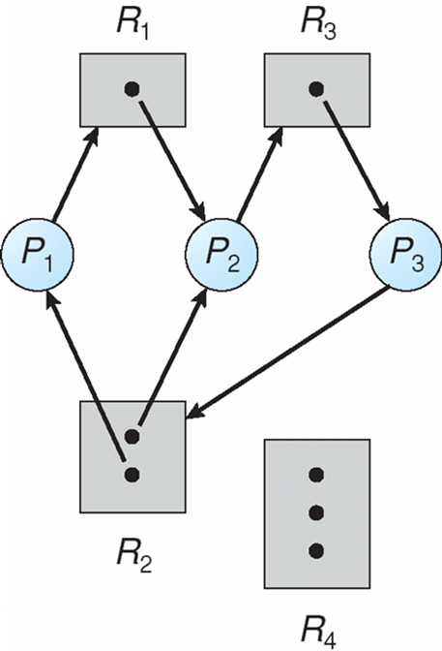
Deadlock

Slide 13
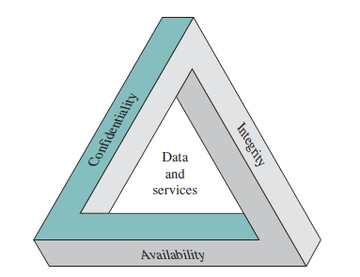
CIA Triad

Slide 14
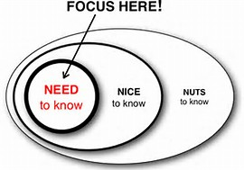
Principle of least privilege

Slide 15
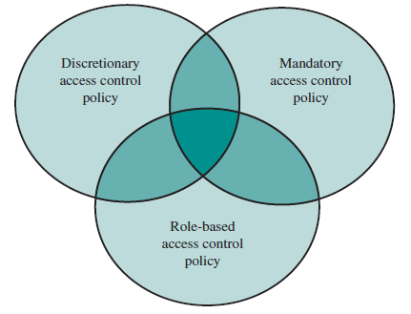
Access Control Policy

Slide 16
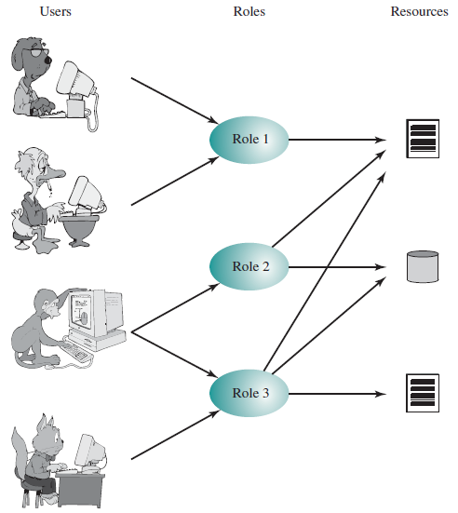
Role-based Access Control

Slide 17
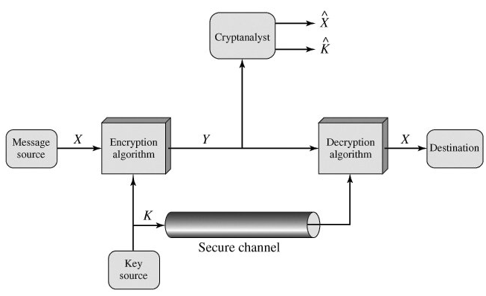
Symmetric Encryption

Slide 18

XOR

Slide 19
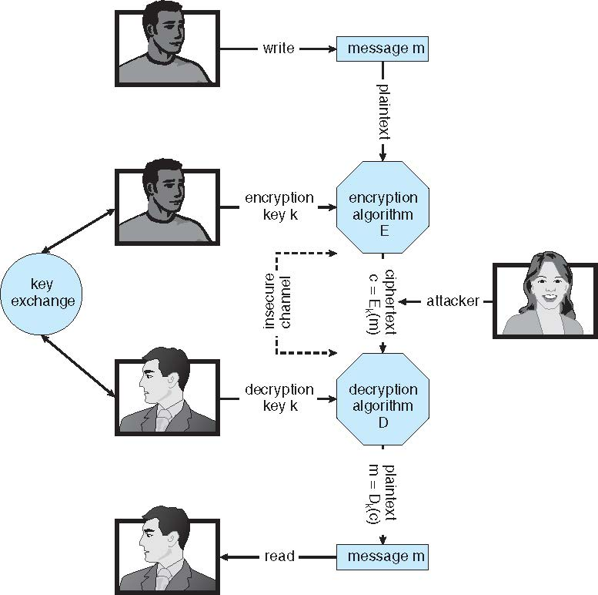
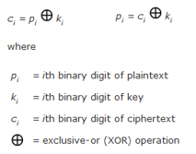
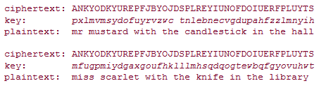
One-Time Pad

Slide 20
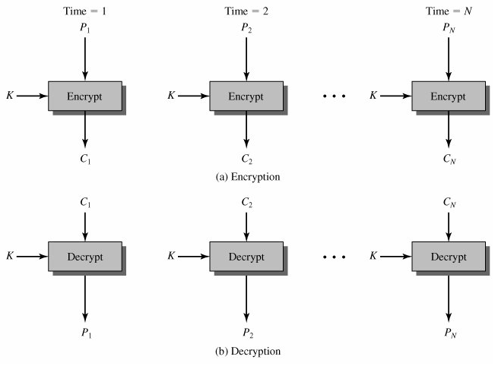
Electronic Codebook Mode

Slide 21
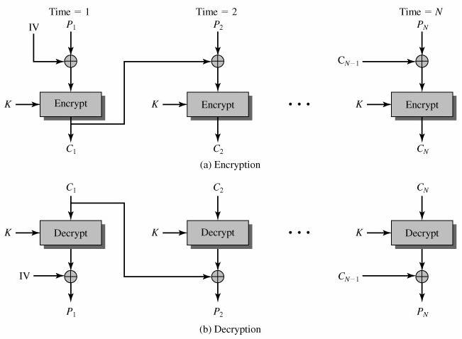
Cipher Block Chaining Mode

Slide 22
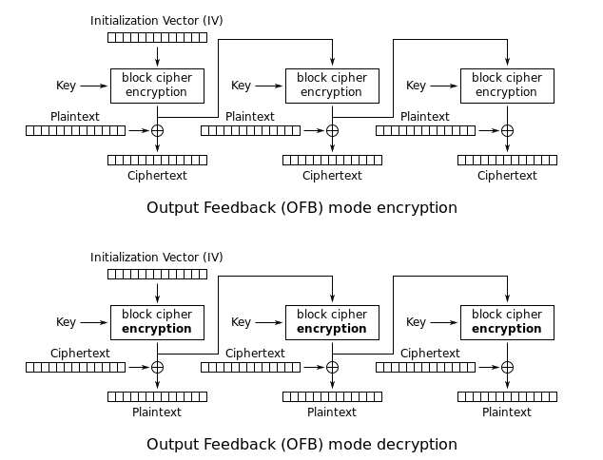
Output Feedback Mode

Slide 23
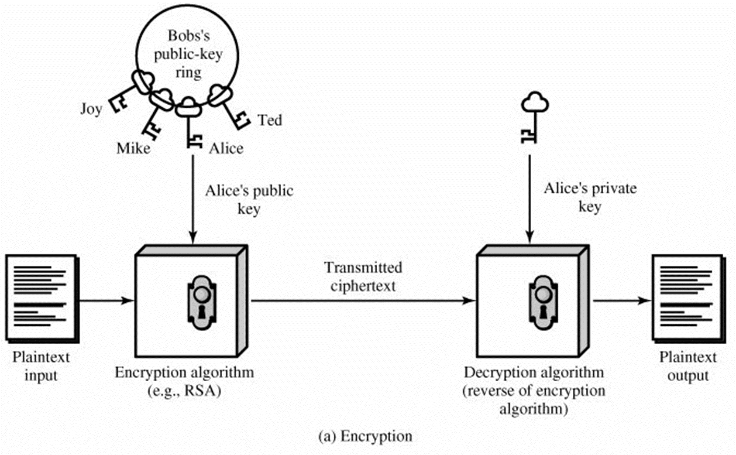
Asymmetric Encryption

Slide 24
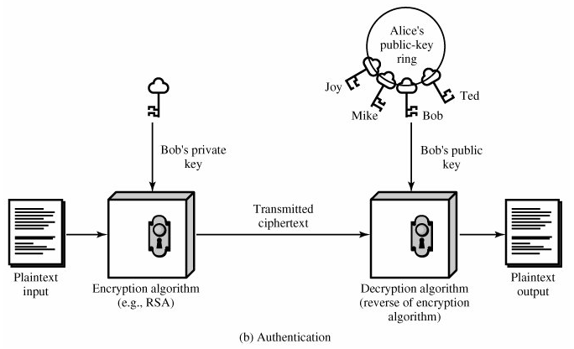

Slide 25
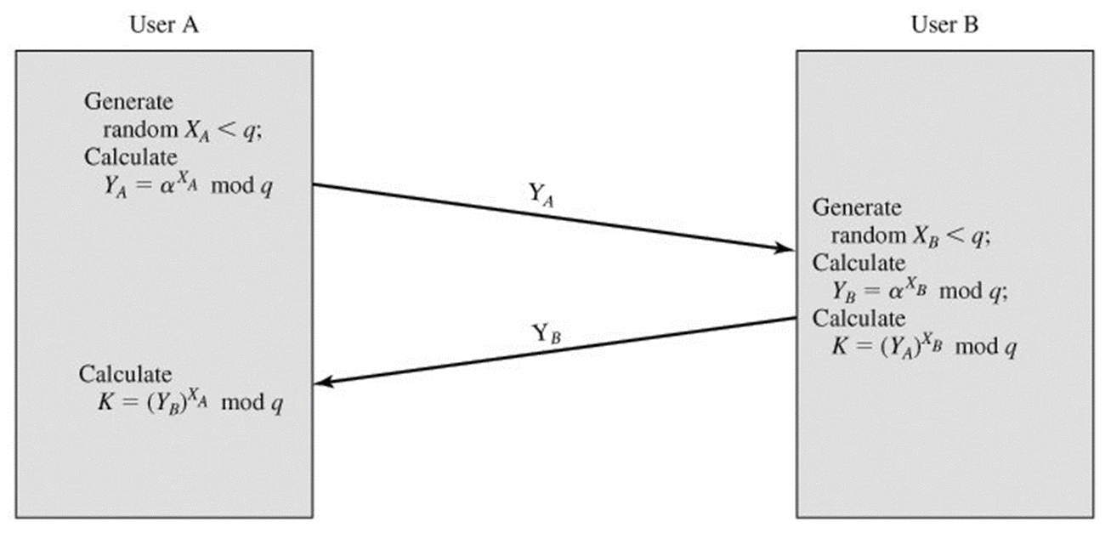
Authentication and Key Exchange
Authentication: hash, MAC, signature
Key exchange

Slide 26
Exam and Marking
Question 1 ~ Question 4,
Each with sub-questions
Question 1: 40 marks
Question 2 ~ 4: 20 marks each
Assignments (Course work) are very important
Final marks = 0.8 * final exam + 0.2 * assignments
E.g. Final exam = 28; assignments = 90; you pass the exam!
E.g. Final exam = 65; assignments = 90; you get A!

